Slide 1

Zkx402
ProofOfLeak
The first cryptographic secure data exchange built for journalists, AI agents, and the truth.

Slide 2

The Problem with Traditional Whistleblowing
Identity Exposure Risk
No Proof of Authenticity
No Monetization Path
Documents can be forged. Recipients can't verify provenance. Trust is everything.
Traditional platforms require trust. Leakers risk exposure. Sources get burned.
Whistleblowers take enormous personal risk. Zero financial protection or compensation.

Slide 3

Three Markets, One Protocol
Whistleblowers
Journalists
AI Agents
Anonymous monetization
Verified discounts
Autonomous purchasing
Sell sensitive data without revealing identity. Cryptographic proof protects source.
Prove outlet affiliation. Get cheaper access to authenticated leaks. Build stories faster.
Inherit journalist discounts via attestations. Buy leaks with x402 payments on Base—no human intervention.

Slide 4
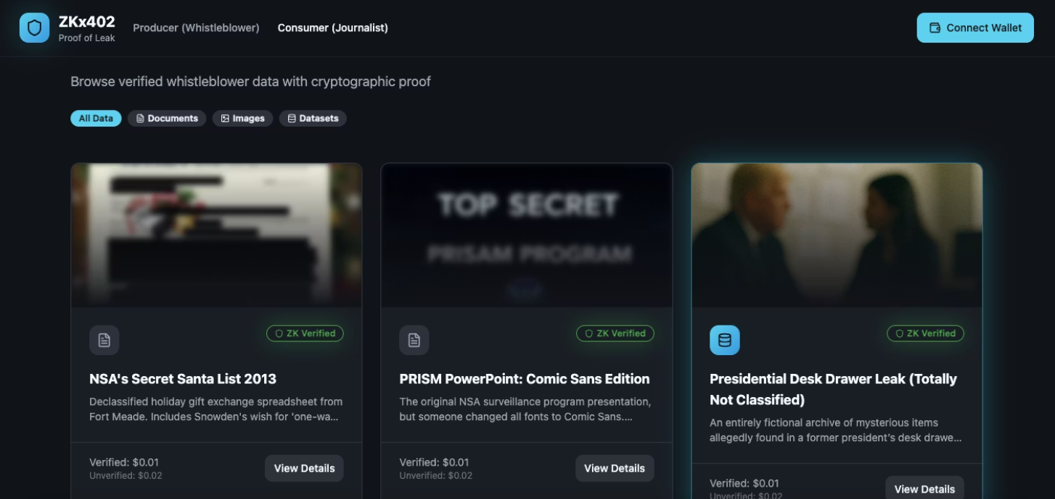
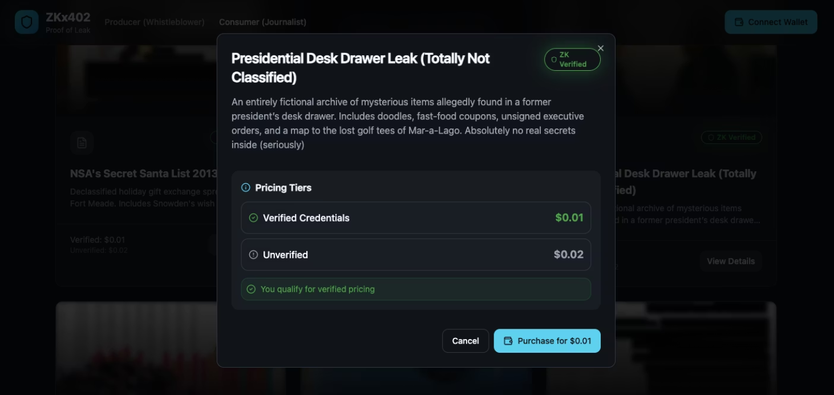
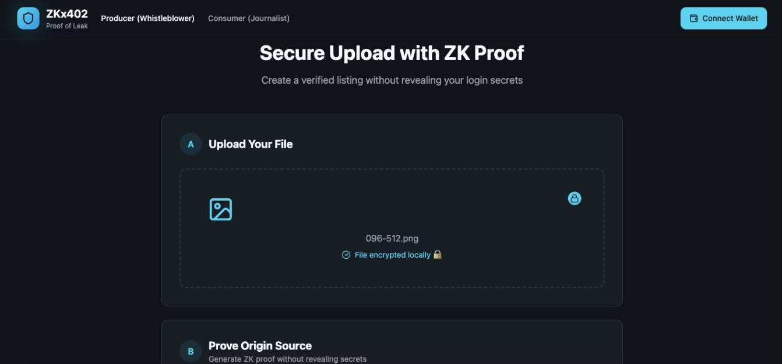
Market Opportunity: Where We Fit
Existing landscape gaps
SecureDrop: No payments, no provenance, no AI integration
WikiLeaks: Centralized, editorial control, legal liability
Data brokers: No whistleblower protection, questionable ethics
ProofOfLeak is the only protocol combining cryptographic authenticity, financial incentives for sources, and native AI agent support.

Slide 5
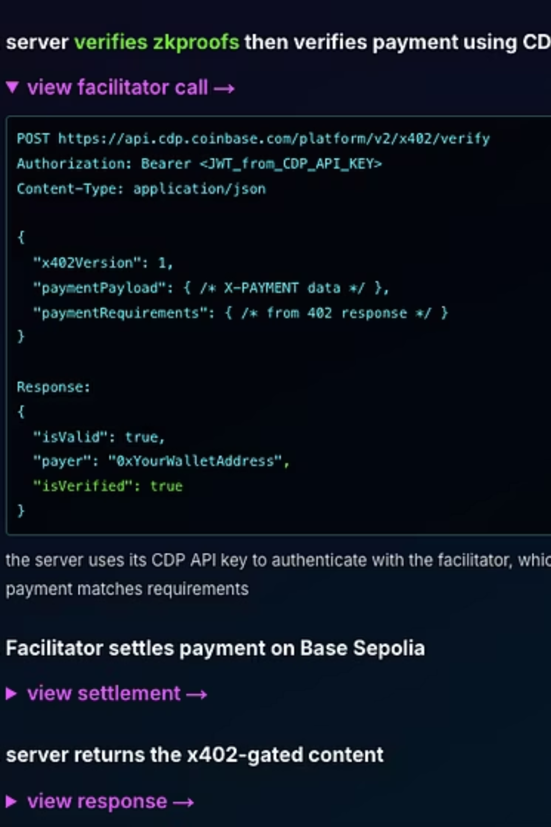

How ProofOfLeak Works
Submit with ZK Proofs
Dynamic Pricing Engine
Whistleblowers upload data with cryptographic authenticity guarantees—no identity required
Verified journalists get discounts.
Autonomous x402 Payments
AI agents buy leaks autonomously on Base. Instant settlement, zero friction

Slide 6
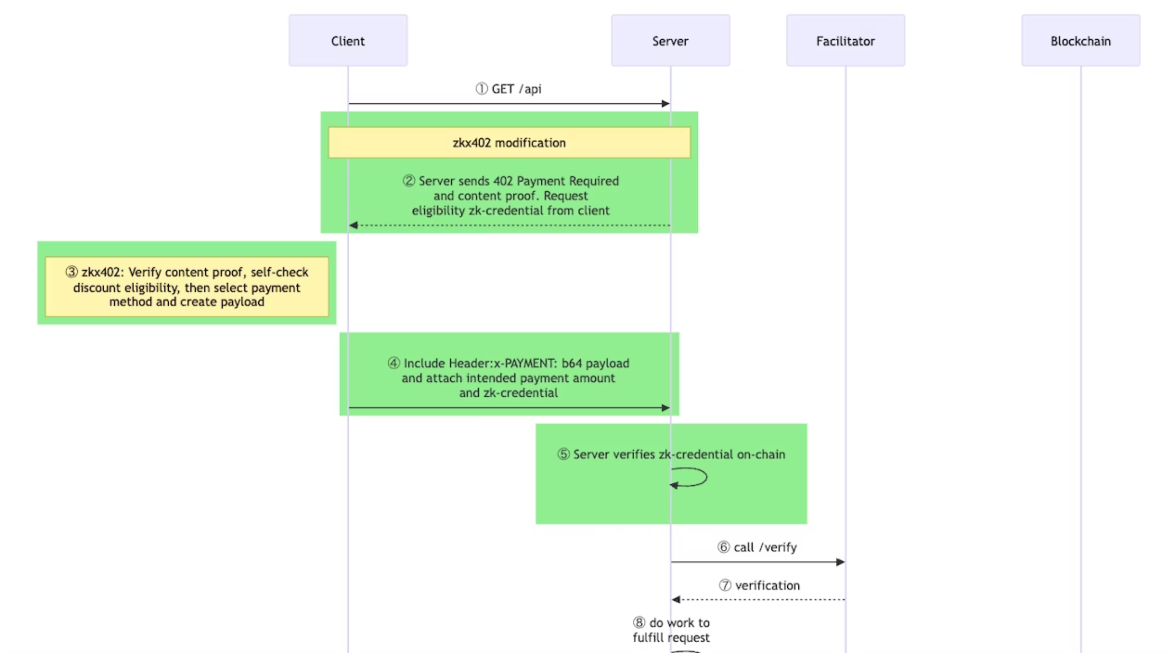
Protocol flow (Part 1)

Slide 7
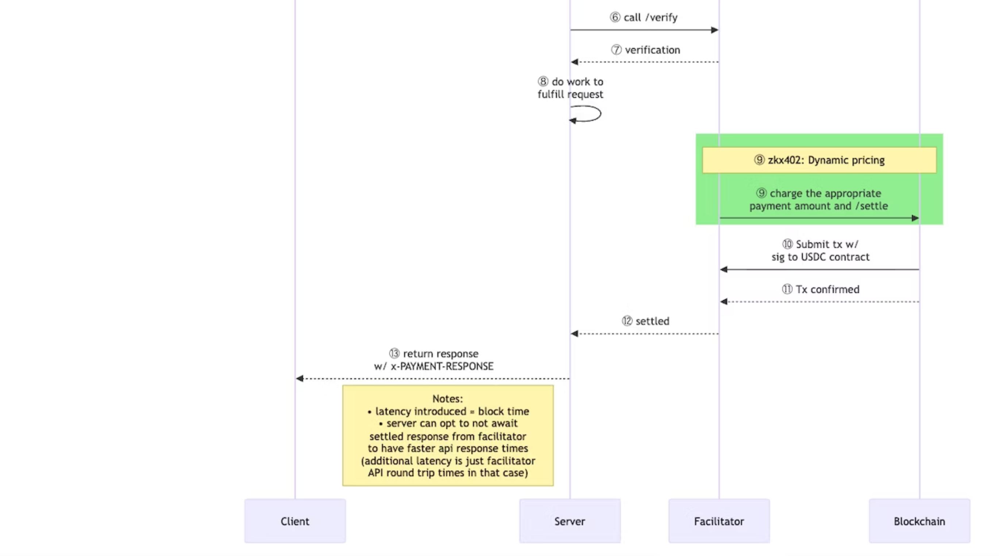
Protocol flow (Part 2)

Slide 8

AI Agent Autonomy: The Future of Investigative Journalism
AI agents can autonomously monitor ProofOfLeak for relevant leaks, verify authenticity through on-chain proofs, and execute purchases using x402 payments—all without human intervention.
Discovery
Agent scans marketplace for keywords and relevance scores
Verification
Validates ZK proofs and assesses data credibility
Acquisition
Executes x402 payment and receives encrypted data

